Slide 1
The Equations of Motion with Rectangular Coordinates
Dr. Jacob Moore
Associate Professor of Engineering
Penn State Mont Alto

Slide 2
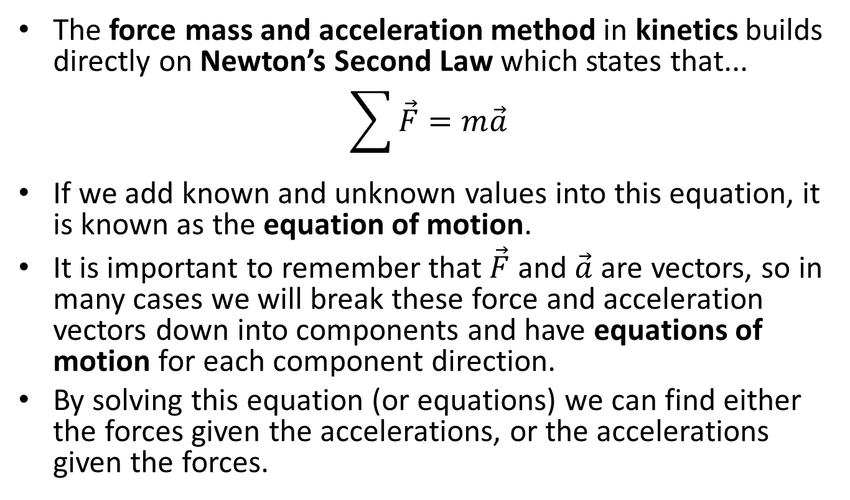
Newton’s Second Law and the Force Mass and Acceleration Method
The force mass and acceleration method in kinetics builds directly on Newton’s Second Law which states that...
$$\sum{\vec{F}}=m\vec{a}$$
If we add known and unknown values into this equation, it is known as the equation of motion.
It is important to remember that $\vec{F}$ and $\vec{a}$ are vectors, so in many cases we will break these force and acceleration vectors down into components and have equations of motion for each component direction.
By solving this equation (or equations) we can find either the forces given the accelerations, or the accelerations given the forces.

Slide 3
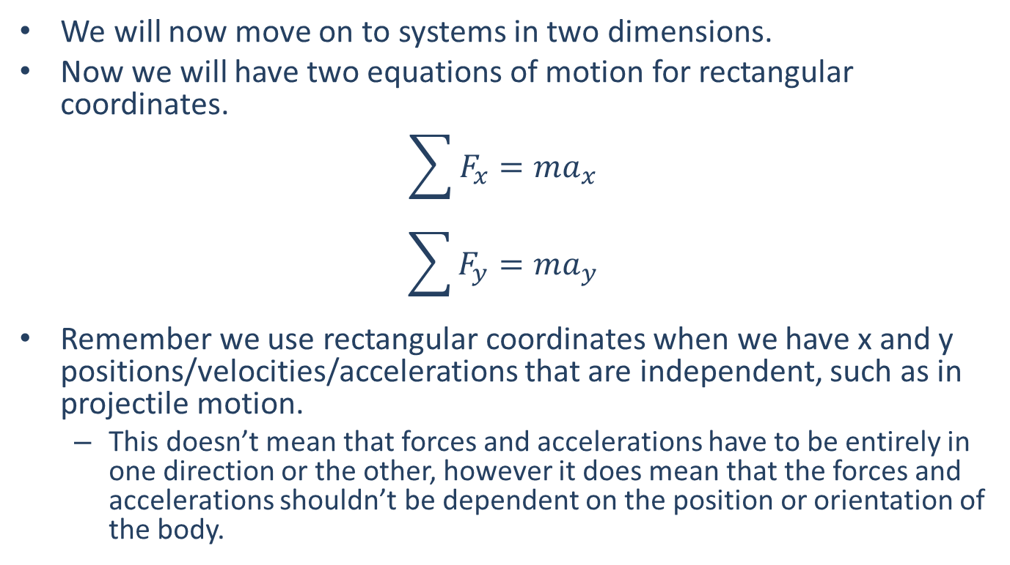
Force Method in Two Dimensions
We will now move on to systems in two dimensions.
Now we will have two equations of motion for rectangular coordinates.
$$\sum{F_{x}=ma_{x}}$$
$$\sum{F_{y}=ma_{y}}$$
Remember we use rectangular coordinates when we have x and y positions/velocities/accelerations that are independent, such as in projectile motion.
This doesn’t mean that forces and accelerations have to be entirely in one direction or the other, however it does mean that the forces and accelerations shouldn’t be dependent on the position or orientation of the body.

Slide 4
Don’t Forget Your Kinematics
It’s important to remember your kinematics, as you will not always be given accelerations, or you will not always be asked for accelerations.
Kinetics will relate forces and accelerations, kinematics will relate accelerations to velocities and positions.
Don’t be afraid of solving for ‘a’ in your kinematics equations or your kinetics equations and substituting/combining these into one another.
Just as with kinematics, time is the variable that will tie the equations of motion together.

Slide 5
Solving a Kinetics Problem (The Process)
The process used in solving a kinetics problem is similar to solving a problem in statics and consists of three steps.
Set up a free body diagram.
Draw the body separated from it’s surroundings
Draw in all the known and unknown forces (I use red for forces) as well as key dimensions and angles (I use blue for dimensions and angles)
Draw in the acceleration vector (I use a blue dashed vector for this)
Use the free body diagram to write out your equations of motion, breaking all forces and accelerations down into x and y components
These may be supplemented with kinematics equations.
Solve the equations for any unknowns.

Slide 6
Thanks for Watching
See other engineering mechanics videos and access the full tool at…

Slide 7




Worked Example
You are controlling a satellite with a mass of 300 kg. The main and lateral thrusters can exert the forces shown. How long do you need to run each of the thrusters to achieve the final velocity as shown in the diagram? Assume the satellite has zero initial velocity.
$$v_{final}=120\frac{m}{s}$$
$$F_{main}=600N$$
$${20}^{o}$$
$$F_{lat}=100 N$$

Slide 8
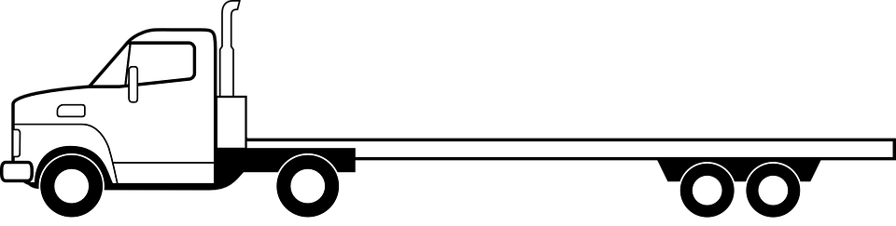
Worked Example
A man in a flat bed truck starts from rest up a hill at an angle of 10 degrees. If he is carrying a 600 kg crate in the back and the static coefficient of friction is .3...
What is the maximum rate of acceleration before the crate slides off of the back of the truck?
How long will it take the truck to reach a speed of 25 m/s?
600 kg

